Slide 1
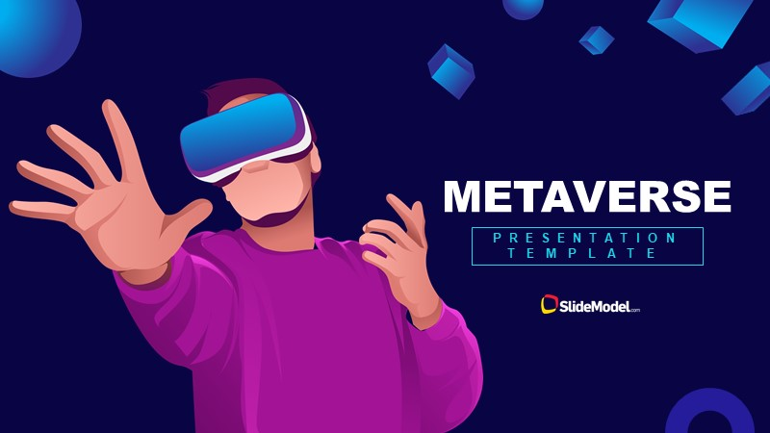

Slide 2
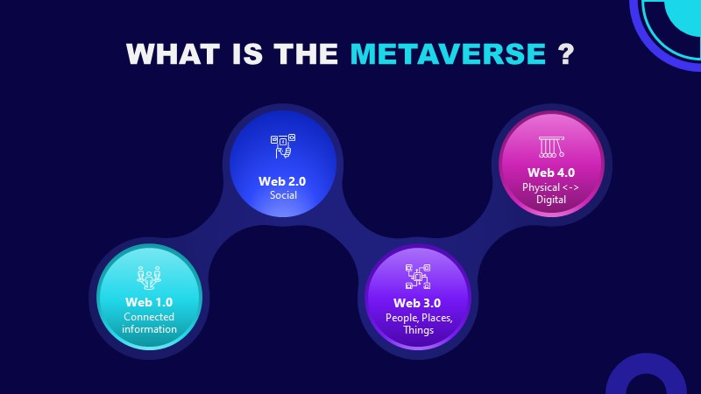
Notes:
The metaverse is a concept of an online, 3D, virtual space connecting users in all aspects of their lives. It would connect multiple platforms, similar to the internet containing different websites accessible through a single browser.
The concept was developed in the science-fiction novel Snow Crash by Neal Stephenson. However, while the idea of a metaverse was once fiction, it now looks like it could be a reality in the future.
The metaverse will be driven by augmented reality, with each user controlling a character or avatar. For example, you might take a mixed reality meeting with an Oculus VR headset in your virtual office, finish work and relax in a blockchain-based game, and then manage your crypto portfolio and finances all inside the metaverse.
You can already see some aspects of the metaverse in existing virtual video game worlds.

Slide 3
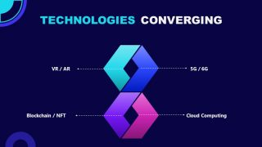
Notes:
Chapter 2 : Confusion and Uncertainty
Mark Zuckerberg’s articulation focused on immersive virtual _{reality}^{#x2021;‡} as well as social experiences that connect individuals who live far apart. Notably, Facebook’s Oculus division is the market leader in VR in both unit sales and investment, while its social network is the largest and most used globally. The Washington Post characterized Epic’s vision of the Metaverse, meanwhile, as “an expansive, digitized communal space where users can mingle freely with brands and one another in ways that permit self-expression and spark joy . . . a kind of online playground where users could join friends to play a multiplayer game like Epic’s ‘Fortnite’ one moment,
watch a movie via Netflix the next and then bring their friends to test drive a new car that’s crafted exactly the same in the real world as it would be in this virtual one. It would not be (in Sweeney’s opinion) the manicured, ad-laden news feed presented by platforms like _{Facebook.”}4
In many cases, the Metaverse discourse showed that executives see the need to use the buzzword before they have any real handle on what it means overall, let alone for their business. In August 2021, Match Group, the owner of dating sites such as Tinder, Hinge, and OKCupid, said that its services would soon receive “augmented features, self-expression tools, conversational AI and a number of what we would consider metaverse elements, which have the element to transform the online meeting and getting-to-know-each other process.” No further details were provided, though presumably its Metaverse initiatives will involve virtual goods, currencies, avatars, and environments that facilitate romance.
After Chinese megacorporations Tencent, Alibaba, and ByteDance began positioning themselves as leaders in the vaguely defined but seemingly imminent Metaverse, their domestic competitors stumbled as they sought to explain how they, too, would become pioneers in this multi-trillion-dollar future. For instance, the head of investor relations at NetEase, another Chinese gaming giant, said on the company’s Q3 2021 earnings call that “The metaverse is indeed the new buzzword everywhere today. But then, on the other hand, I think nobody has actually had firsthand experience in what it is. But at NetEase, we are technologically ready. We know how to accumulate the relevant know-how, the relevant skillsets when that day comes. So, I think when that day eventually comes, we’d probably be one of the fastest runners in the _{metaverse space.”}5

Slide 4
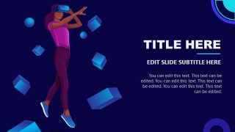
Chapter 3 A Definition Finally
fdffdfdffdf

Slide 5
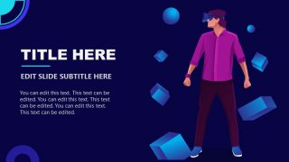
The Next Internet

Slide 6
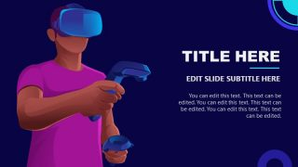
Benefits of Next Technology
By removing distance, connecting everyone and everything, and unleashing massive flows of information, the internet has been the greatest disruption since the printing press. In a few decades, it has reshaped much of the human world, enabling great progress and historic change, and revealing the many challenges that come with such transformation. There is now a growing need for standardization and interoperability across services and systems, more coherency around market fragmentation, more intuitive and seamless user interfaces, and governance that effectively regulates content and experiences while still supporting progress.1 Smart cooperation and governance by providers and regulators may be critical to overcoming Web2-era challenges and enabling the next internet platform: the metaverse and Web3.

Slide 7
The metaverse is emerging from our digital behaviors
Today, people often socialize through global networks, modifying their appearance with augmented reality filters that can see and respond to faces, wrapping themselves in avatars, buying virtual clothes, and attending concerts in massive game worlds.3 Businesses hold face-to-face meetings remotely and virtually, and can don VR and AR headsets to train, visualize, and collaborate. Generation Z ranks playing video games as their favorite form of media and entertainment.4 Even before the nonfungible token (NFT) boom, some game worlds were running out of virtual real estate to meet the demand of players.5 Remarkably, one poll found that over half of people in nine markets prefer to spend their time online rather than in the real world.6 Several generations have become accustomed to digital interfaces, software and interactivity, and global connectivity. We immerse into the digital and increasingly draw it out across the physical world. Amidst the hype and critique, it is these behaviors and uses that are invoking Web3 and the metaverse.

Slide 8
Enabling seamless movement across the metaverse
One of the more common promises of the metaverse vision is the portability and interoperability of identity, data, and digital assets. For example, if a consumer buys an exclusive digital item for their avatar from one service, like a piece of virtual clothing, they can go to a second service that will recognize their ownership of the item and render it effectively. For the enterprise, a similar use case might involve being able to invite users across a partner ecosystem into a shared immersive collaboration. This might mean reviewing the 3D assembly of a prototype vehicle or inspecting a digital twin of a factory for performance enhancements.
This capability may require new ways of organizing identity, ownership, and even storage. Digital identity is often fragmented across services, with multiple logins and passcodes. Likewise, digital assets such as personal avatars and virtual clothing are designed to work in the service providing them, not for portability elsewhere. Currently, only the service knows you “own” the asset, and only the service can load and render that asset. This concentration of user identity, data, and ownership within a given service is what is referred to as “centralization

Slide 9
Building capacity for tomorrow
It can be hard to navigate so much change and discontinuity amidst all the hype and criticism surrounding Web3 and the metaverse. The foundations of Web3 are already in place and will continue to seek value and weed out the problems. Many metaverse capabilities and behaviors exist, inspiring the largest platform and digital lifestyle providers to mobilize enormous amounts of capital towards its success.
Leaders should examine their businesses and customers, looking for areas where Web3 protocols can create unique and compelling experiences, enable greater efficiency, and address regulatory pressures. Some may be able to productize virtual goods, extend their brands, or offer enterprise services through metaverse experiences. Some may need to build out their networks, cloud, compute, and storage capacity, while adding the talent necessary to execute on these next-generation capabilities.30 If data is being generated exponentially by metaverse interactions, businesses may need new solutions in place to operate on that data continuously and effectively, while also adhering to evolving regulatory and compliance regimes. Additionally, businesses could leverage cryptocurrency and smart contracts to manage finances with much greater velocity, essentially automating capital and making their money programmable

Slide 10
